Slide 1

Bài xxx: SQL
Giảng viên: Nguyễn Quang Huy
Email: HuyNQ12@topica.edu.vn
‹#›
Notes:
https://www.w3schools.com/sql/default.asp
https://github.com/datacharmer/test_db

Slide 2
Nội dung
1.SQL Constraints
2.SELECT WITH JOIN
3.SELECT WITH SUBQUERY
4.PAGINATION
5.SQL Injection
6.PARTITION & SHARDING
QA & DEMO
‹#›
Notes:
https://www.w3schools.com/sql/default.asp
https://github.com/datacharmer/test_db

Slide 3
1.SQL Constraints
NOT NULL - Ensures that a column cannot have a NULL value
UNIQUE - Ensures that all values in a column are different
PRIMARY KEY - A combination of a NOT NULL and UNIQUE. Uniquely identifies each row in a table
FOREIGN KEY - Uniquely identifies a row/record in another table
CHECK - Ensures that all values in a column satisfies a specific condition
DEFAULT - Sets a default value for a column when no value is specified
INDEX - Used to create and retrieve data from the database very quickly

Slide 4
1.SQL Constraints (unique)
CREATE TABLE Persons (
ID int NOT NULL,
LastName varchar(255) NOT NULL,
FirstName varchar(255),
Age int,
CONSTRAINT UC_Person UNIQUE (ID,LastName)
);
ALTER TABLE Persons
ADD CONSTRAINT UC_Person UNIQUE (ID,LastName);

Slide 5
1.SQL Constraints (default)
CREATE TABLE Persons (
ID int NOT NULL,
LastName varchar(255) NOT NULL,
FirstName varchar(255),
Age int,
City varchar(255) DEFAULT 'Sandnes'
);
CREATE TABLE Orders (
ID int NOT NULL,
OrderNumber int NOT NULL,
OrderDate date DEFAULT GETDATE()
);

Slide 6
1.SQL Constraints (index)
CREATE INDEX idx_lastname
ON Persons (LastName);
CREATE INDEX idx_pname
ON Persons (LastName, FirstName);

Slide 7
1.SQL Constraints (check)
CREATE TABLE Persons (
ID int NOT NULL,
LastName varchar(255) NOT NULL,
FirstName varchar(255),
Age int,
City varchar(255),
CONSTRAINT CHK_Person CHECK (Age>=18 AND City='Sandnes')
);
ALTER TABLE Persons
ADD CONSTRAINT CHK_PersonAge CHECK (Age>=18 AND City='Sandnes');

Slide 8
1.SQL Constraints (AUTO INCREMENT)
CREATE TABLE Persons (
Personid int NOT NULL AUTO_INCREMENT,
LastName varchar(255) NOT NULL,
FirstName varchar(255),
Age int,
PRIMARY KEY (Personid)
);
CREATE TABLE Persons (
Personid int IDENTITY(1,1) PRIMARY KEY,
LastName varchar(255) NOT NULL,
FirstName varchar(255),
Age int
);
CREATE SEQUENCE seq_person MINVALUE START WITH 1 INCREMENT BY 1 CACHE 10;
INSERT INTO Persons (Personid,FirstName,LastName)
VALUES (seq_person.nextval,'Lars','Monsen');

Slide 9
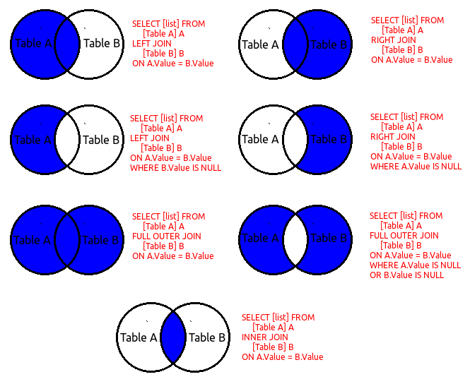
2.SELECT WITH JOIN

Slide 10
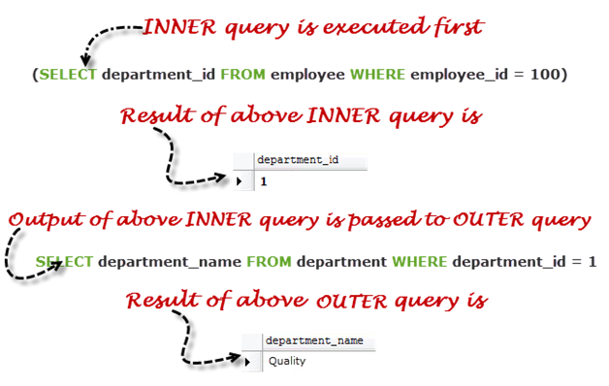
3.SELECT WITH SUBQUERY
SELECT department_name FROM department
WHERE department_id =
(
SELECT department_id FROM employee WHERE employee_id = 100
);

Slide 11
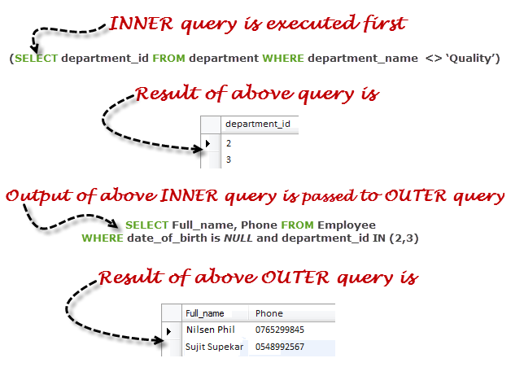
3.SELECT WITH SUBQUERY (cont)
SELECT Full_name,Phone FROM Employee
WHERE date_of_birth is NULL and department_id IN
(
SELECT department_id FROM department WHERE department_name <> ‘Quality’
);

Slide 12
3.SELECT WITH SUBQUERY (cont)
SELECT Full_name,Phone FROM Employee
WHERE date_of_birth is NULL and department_id IN
(
SELECT department_id FROM department WHERE department_name <> ‘Quality’
);

Slide 13
4.PAGINATION
SELECT TOP 3 * FROM Customers;
SELECT * FROM Customers ORDER BY id OFFSET 10 ROWS FETCH NEXT 10 ROWS ONLY; # NOT TEST
SELECT * FROM Customers
LIMIT 3;
SELECT * FROM Customers
LIMIT 5,10; # Retrieve rows 6-15
SELECT * FROM Customers
WHERE ROWNUM <= 3;
SELECT * FROM Customers ORDER BY id OFFSET 10 ROWS FETCH NEXT 10 ROWS ONLY
Notes:
https://docs.microsoft.com/en-us/sql/t-sql/queries/select-order-by-clause-transact-sql?view=sql-server-2017#Offset
https://docs.oracle.com/javadb/10.8.3.0/ref/rrefsqljoffsetfetch.html

Slide 14
5.SQL Injection
Login
SELECT * FROM USER where USERNAME = “” and PASSWORD=””
Injection:
SELECT * FROM USER where USERNAME = “” or 1=1 AND PASSWORD=”” or 1=1
Prevent SQL Injection

Slide 15
6.PARTITION & SHARDING
MySQL partitioning
MSSQL partitioning
PARTITION vs SHARDING?

Slide 16

‹#›

Slide 17

‹#›

Slide 18
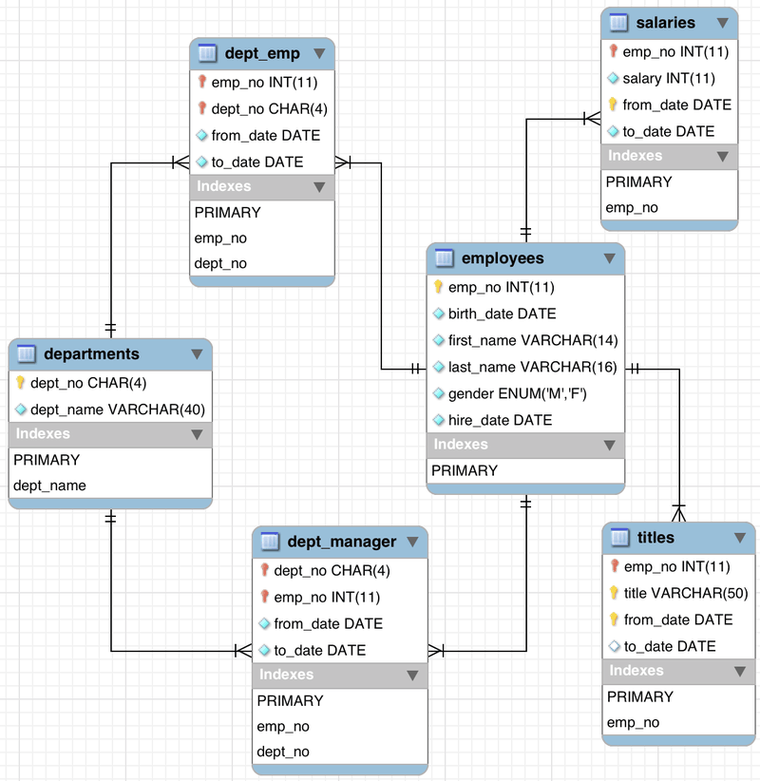
Notes:
https://dev.mysql.com/doc/employee/en/sakila-structure.html
Danh sách nhân viên có lương lớn hơn 70.000
Danh sách phòng có trưởng phòng (Staff) có lương lớn hơn 100.000

Slide 19
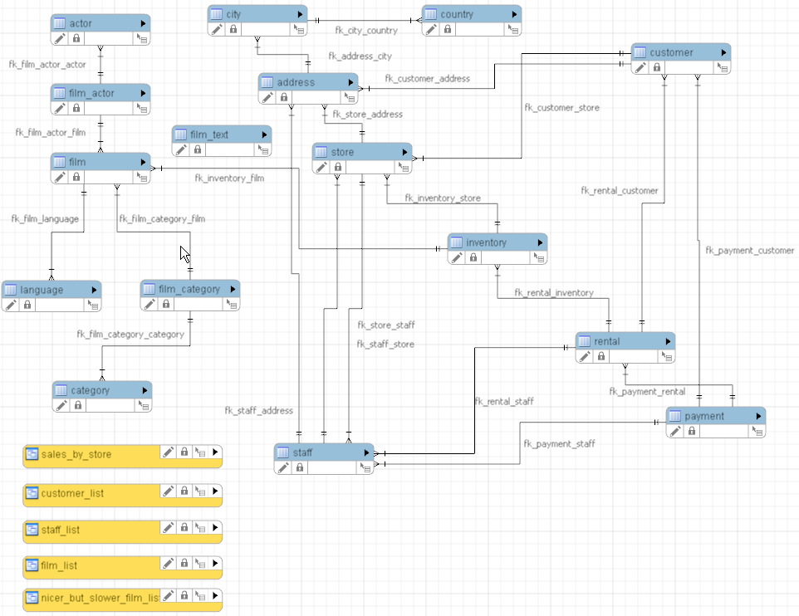
Notes:
https://dev.mysql.com/doc/sakila/en/sakila-structure.html
Danh sách diễn viên nữ đã đóng thể loại phim “Drama“ trong năm 2006
Danh sách khách hàng (với thông tin địa chỉ) đã mua phim “KING EVOLUTION”

